Slide 1
INPUT IMAGE
PREPROCESSING
DIMENSIONALITY REDUCTION
FEATURE EXTRACTION
CLASSIFICATION

Slide 2
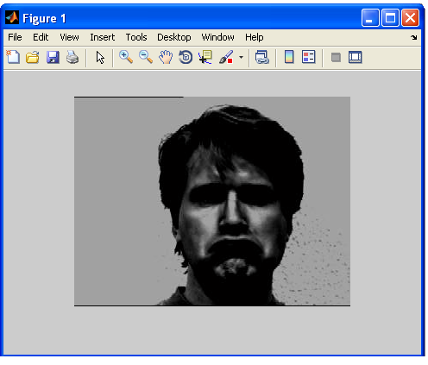
INPUT IMAGE

Slide 3
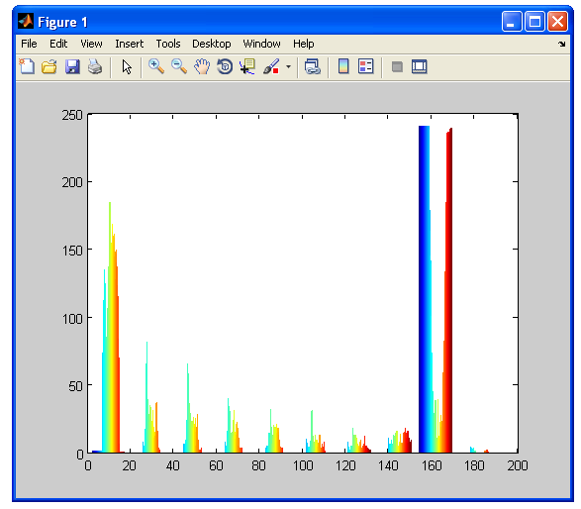
HISTOGRAM OF INPUT IMAGE

Slide 4
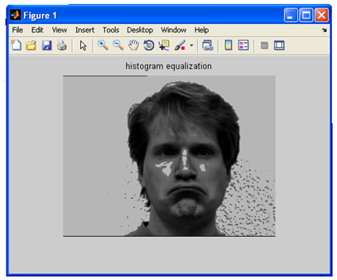
HISTOGRAM EQUALIZED IMAGE

Slide 5
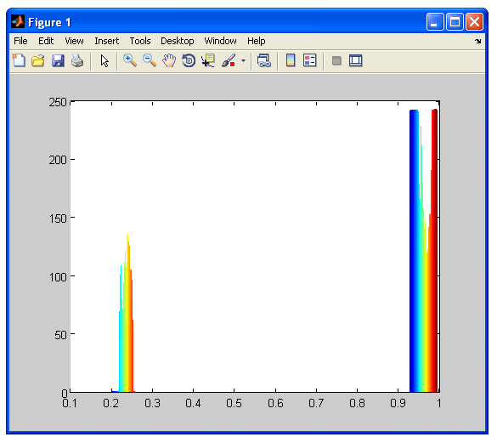
HISTOGRAM OF INPUT IMAGE AFTER EQUALIZATION

Slide 6
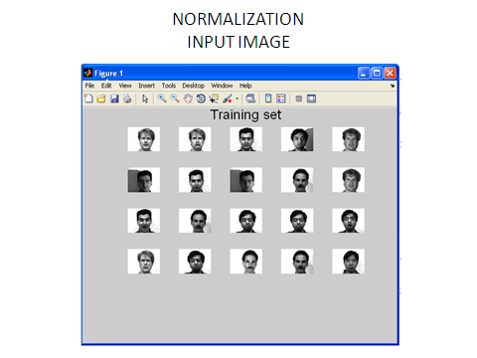

Slide 7
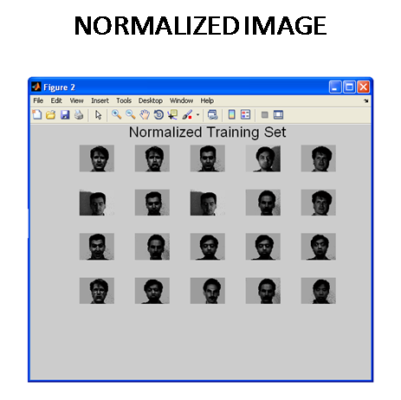

Slide 8
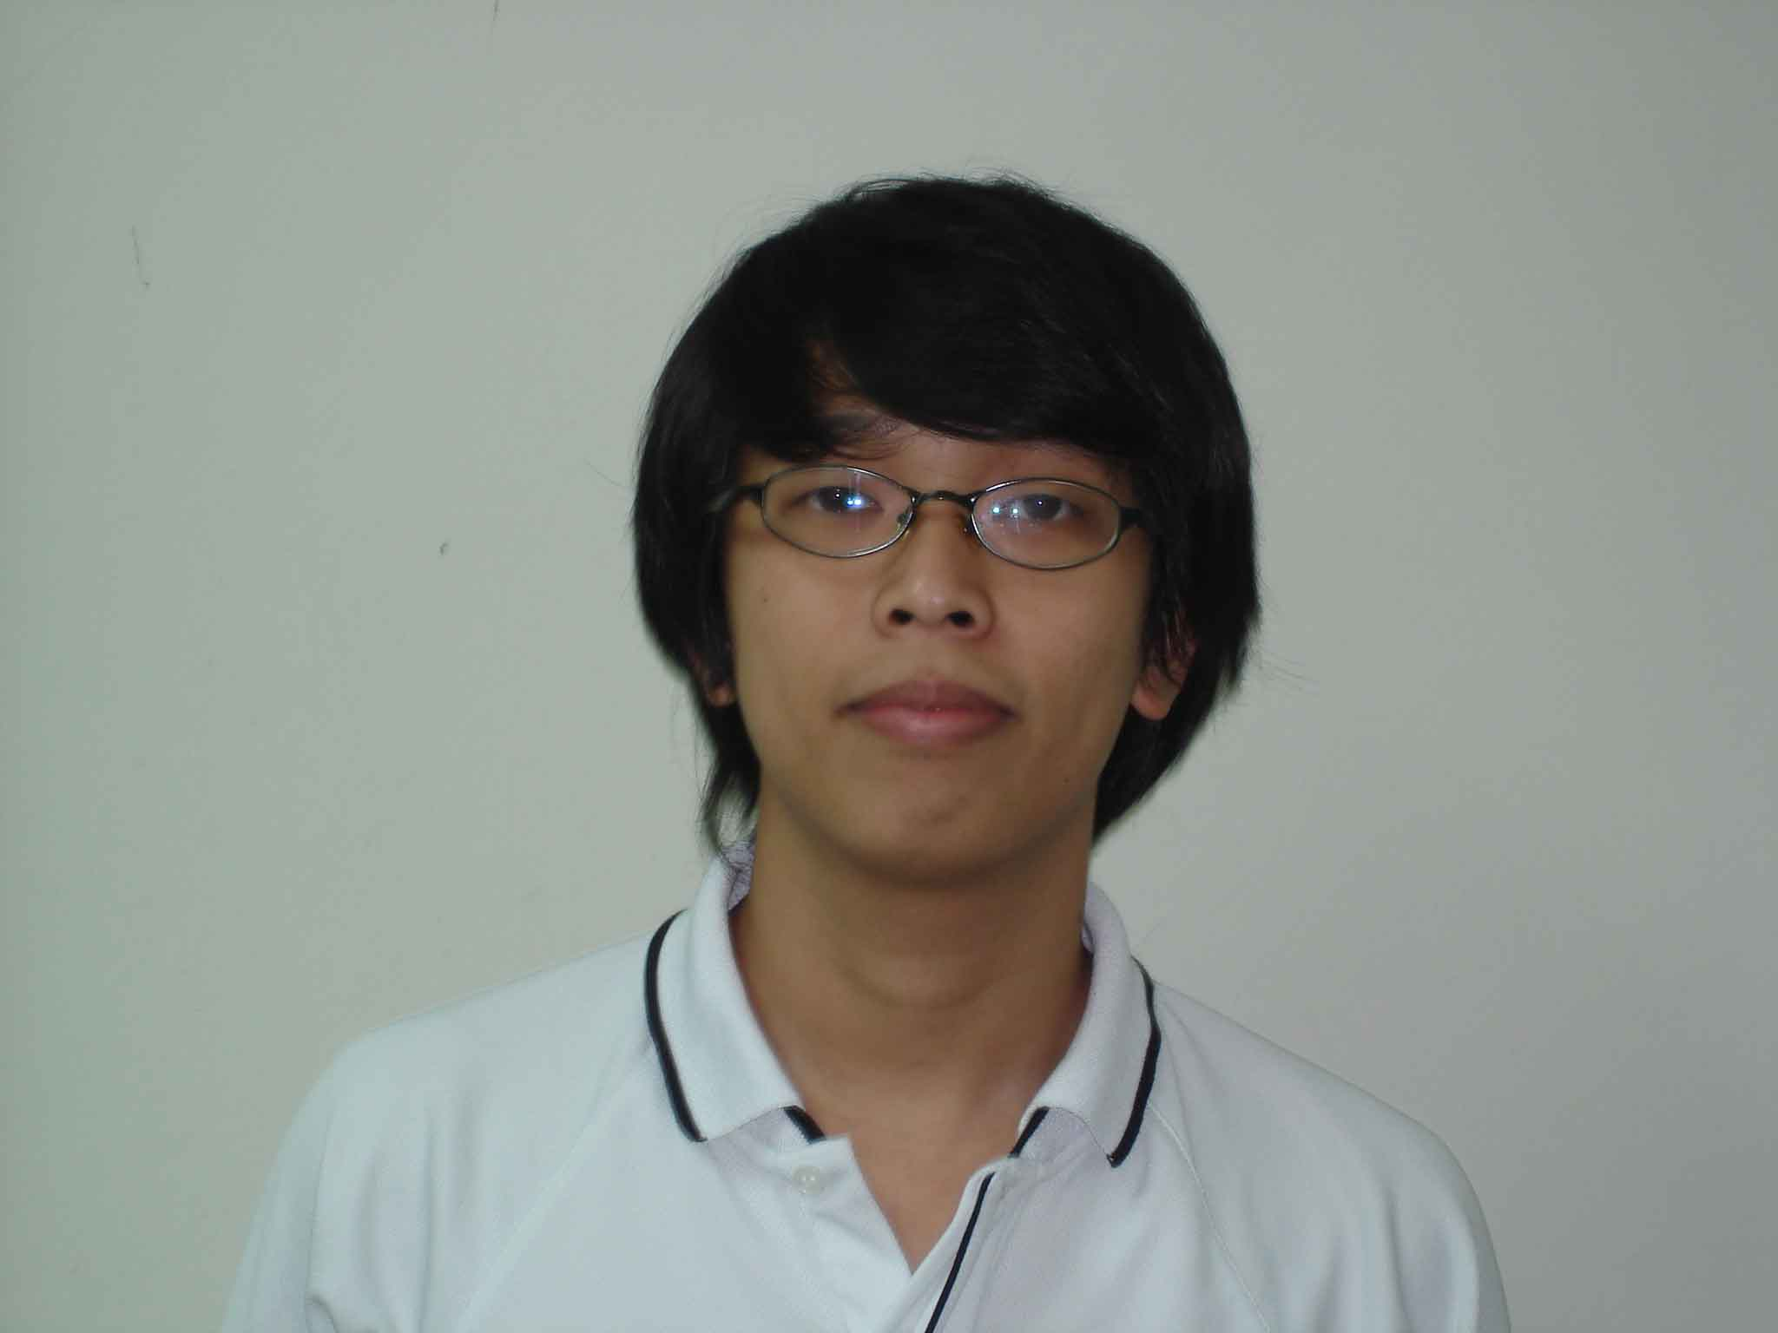
INPUT IMAGE FOR SCALING

Slide 9
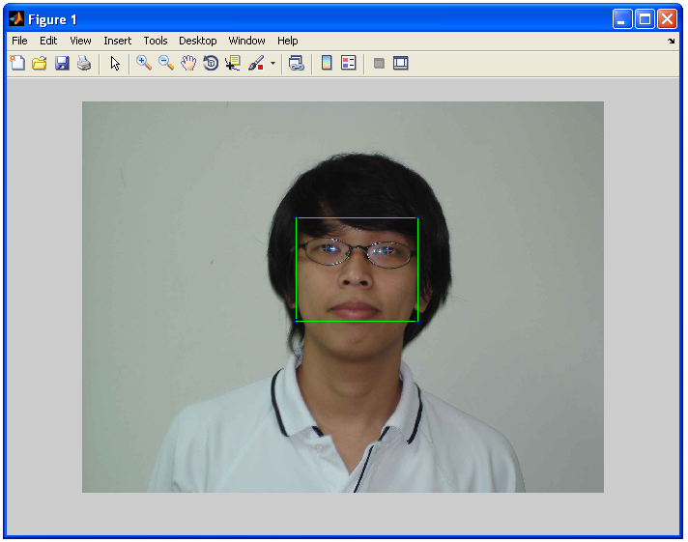
SCALED IMAGE

Slide 10
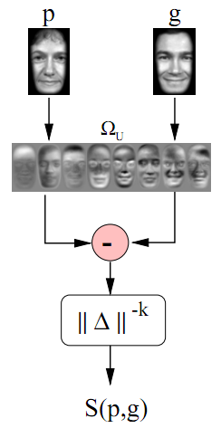
EIGENFACE SIMILARITY

Slide 11
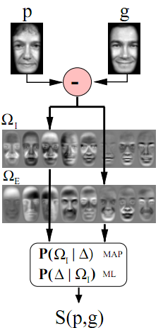
PROBABILISTIC SIMILARITY

Slide 12
RESULTS
EIGENFACES BASED FACE RECOGNITION

Slide 14
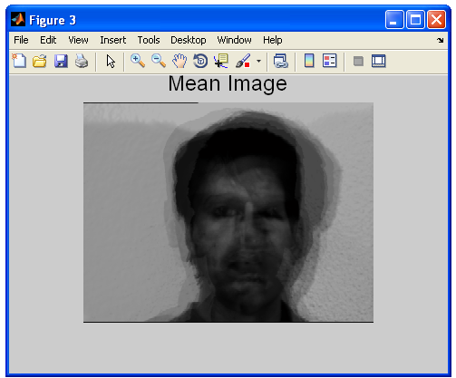
MEAN IMAGE

Slide 15
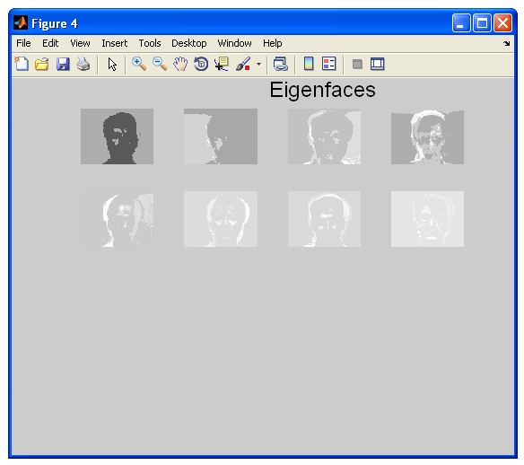
EIGENFACES

Slide 16
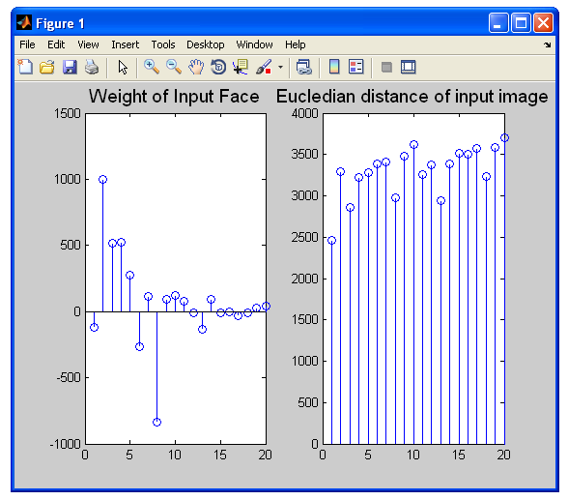
EUCLIDEAN DISTANCE

Slide 17
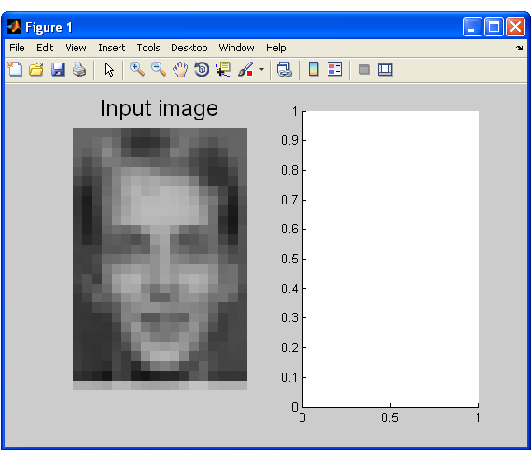
UNIDENTIFIED IMAGE

Slide 18
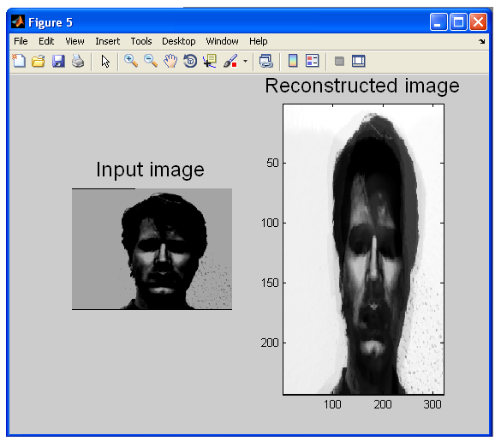
RECONSTRUCTED IMAGE

Slide 19
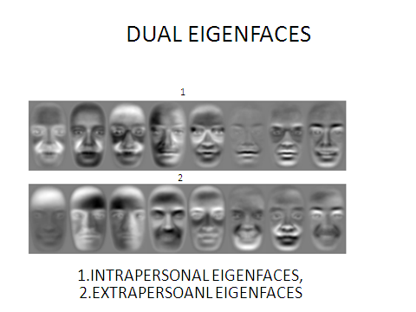

Slide 20
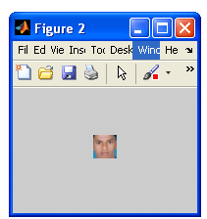
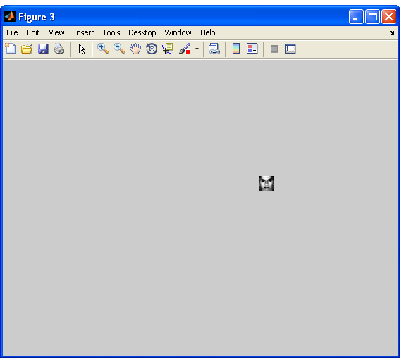
24 X 24 SCALED IMAGE
GRAYSCALE IMAGE

Slide 21

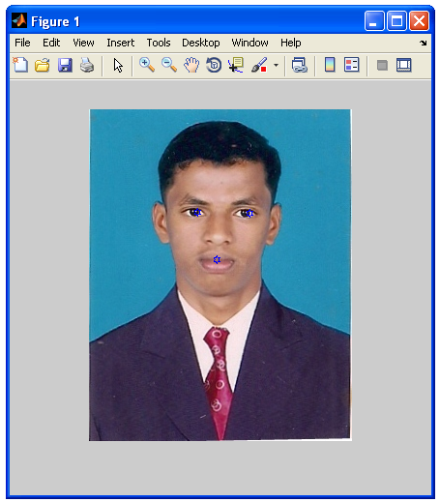
BAYESIAN APPROACH BASED FACE RECOGNITION
INPUT IMAGE
SELECTING FEATURES

Slide 22
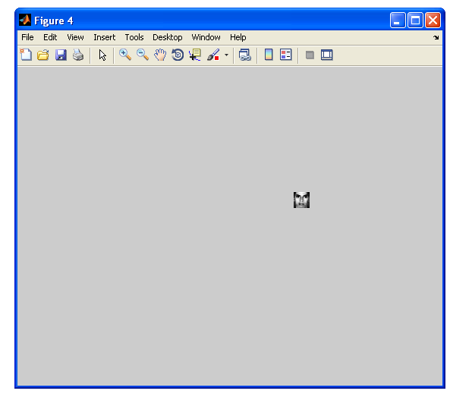
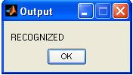
RECOGNIZED IMAGE

Slide 23
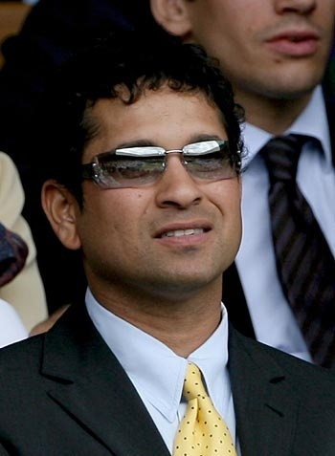
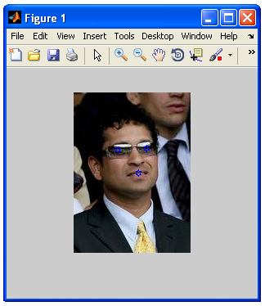
INPUT IMAGE
SELECTING FEATURES

Slide 24
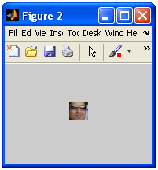
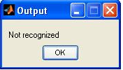
24 X 24 SCALED IMAGE
OUTPUT

